Slide 1
Angular basics 2
Hardeep Kaur Dhalla

Slide 2
Objectives
Workspace and project file structure
How an angular application works?
Understanding Modules and Components
Create angular components

Slide 3

Workspace and project file structure
A workspace contains the files for one or more projects.
A project is the set of files that comprise a standalone application or a shareable library.
The Angular CLI ng new command creates a new project.

Slide 4
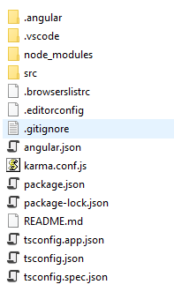
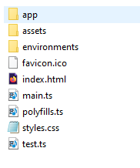

Workspace and project file structure

Slide 5
Workspace and project file structure
Node_modules – this folder contains NPM packages.
Angular.json – configuration for angular development tools.
Package.json – details of required NPM packages by the app and tools.
Tsconfig.json – configuration for typescript compiler.
src – application’s source code, resources and configuration files.
App – contains application’s source code.
Assets – for static resources such as images
Environments- by default only setting production flag is set to true.
Index.html – this is the file sent to the browser.

Slide 6
Workspace and project file structure
styles.css – to define CSS styles that are applied throughout the application.
tests.ts – this is the configuration file for Karma test package.

Slide 7
What is angular?
It is a component-based framework for building scalable web applications.
To understand the capabilities of the Angular framework, you need to learn about the following:
Components
Templates
Directives
Dependency injection

Slide 8
How an angular application works?
Let us understand the process of bootstrapping an angular application.
Role of main.ts, AppModule, AppComponent, index.html etc.

Slide 9
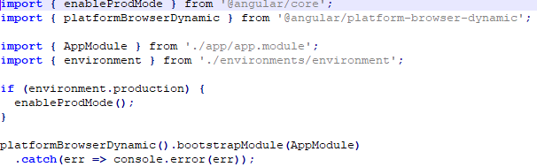
How an angular application works?
Starting point is index.html file in the src folder when browser sends a request to the HTTP server.
This file is modified to include script files and component content.
The main.ts is responsible for starting the application.

Slide 10
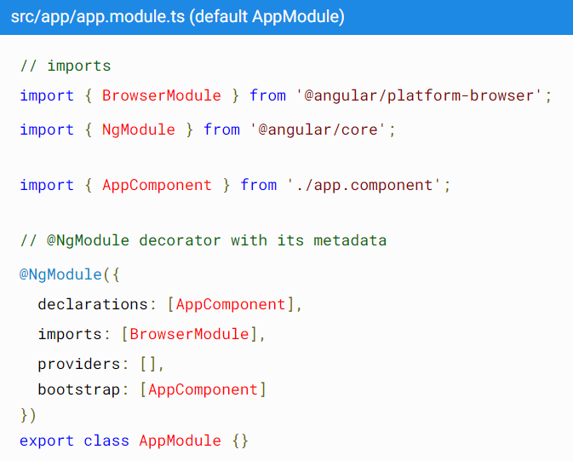
How an angular application works?
Next control goes to
the app.module.ts

Slide 11
Modules
Every Angular application has a root module, conventionally named AppModule, which provides the bootstrap mechanism that launches the application.
An application typically contains many functional modules.
Organizing your code into distinct functional modules helps in managing development of complex applications, and in designing for reusability.

Slide 12
NgModule
Modules are a great way to organize an application and extend it with capabilities from external libraries.
Angular libraries are NgModules, such as FormsModule, HttpClientModule, and RouterModule.
Many third-party libraries are available as NgModules such as Material Design, Ionic, and AngularFire2
Every Angular application has a root module.
By convention, the class is called AppModule and resides in a file named app.module.ts.

Slide 13
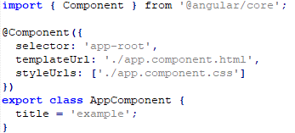
How an angular application works?
app.component.ts file

Slide 14
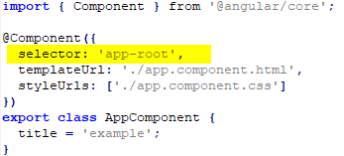
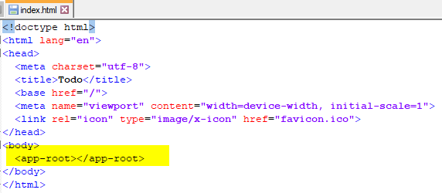
How an angular application works?
Understanding how content is displayed

Slide 15
Angular Components Overview
Every Angular application has at least one component, the root component that connects a component hierarchy with the page document object model (DOM).
Components are the main building block for Angular applications. Each component consists of:
An HTML template that declares what renders on the page
A Typescript class that defines behavior
A CSS selector that defines how the component is used in a template.

Slide 16
Creating a component
Creating a component using the Angular CLI.
Creating a component manually.

Slide 17
Creating a component using the Angular CLI.
From a terminal window, navigate to the directory containing your application.
Run the ng generate component <component-name> command
By default, this command creates the following:
A folder named after the component
A component file, <component-name>.component.ts
A template file, <component-name>.component.html
A CSS file, <component-name>.component.css
A testing specification file, <component-name>.component.spec.ts
Where <component-name> is the name of your component.

Slide 18
Understanding an angular component.
import { Component } from '@angular/core’;
@Component({
selector: 'app-component-overview',
templateUrl: './component-overview.component.html',
styleUrls: ['./component-overview.component.css']
})
The @Component() decorator identifies the class immediately below it as a component.
Decorators are functions that modify JavaScript classes and adds metadata to classes, so that the system knows what those classes mean and how they should work.

Slide 19
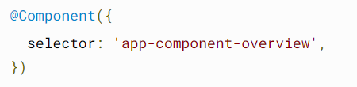
Specifying a component's CSS selector
Every component requires a CSS selector.
A selector instructs Angular to instantiate this component wherever it finds the corresponding tag in template HTML.
The app-component-overview tag is where our application will be rendered.
We want to be able to use this component in our markup by using app-component-overview tag.

Slide 20
Templates
A template combines HTML with Angular markup that can modify HTML elements before they are displayed.

Slide 21
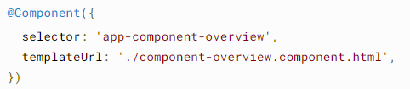
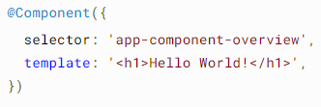
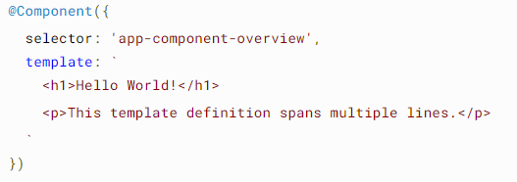
Defining a component's template

Slide 22
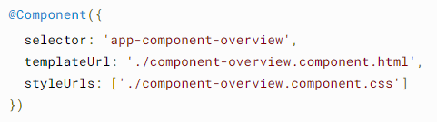
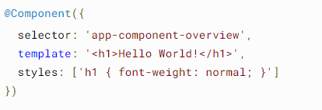
Declaring a component's styles
Declare component styles uses for its template in one of two ways: by referencing an external file, or directly within the component.

